Slide 1

Strategic Initiatives to Boosting Enrollment:
What Worked for Us
Presented by:
Lindsay Henderson, MA, BAS, CST
Associate Dean of Allied Health & Workforce
Fletcher Technical Community College
&
Terri Ferreira, BAS, CST
Program Director/ Instructor
Fletcher Technical Community College

Slide 2
Presentation Objectives
Explore factors influencing students’ decision to choose surgical technology as their major
Identify barriers to enrollment and retention
Highlight initiatives implemented at Fletcher Technical Community College that successfully boosted program enrollment and improved retention rates
Q&A session and collaborative discussion

Slide 3
Why Do Students Choose Surgical Technology as a Major?
Passion for Healthcare
Interest in Surgery
Rapid Career Entry
Strong Job Demand
Hands-on Learning, Teamwork
Opportunities for Growth
Hands-On, Rewarding Work
Notes:
Passion for Healthcare
Many students are drawn to the idea of making a tangible impact on patient care and being part of life-saving procedures.
Interest in Surgery
The unique opportunity to work in an operating room environment is exciting for individuals who thrive in high-stakes, fast-paced settings.
Rapid Career Entry
Surgical Technology programs often allow students to enter the workforce relatively quickly, with most programs lasting 1-2 years.
Strong Job Demand
The growing need for surgical technologists ensures job security and opportunities across diverse healthcare settings.
Opportunities for Growth
Surgical technologists can advance their careers by specializing in specific types of surgery or pursuing further education in related healthcare fields.
Team-Oriented Work
Students who enjoy collaboration and teamwork are often drawn to the role, as surgical technologists are integral members of the surgical team.
Hands-On, Rewarding Work
The opportunity to work directly in surgeries, manage instruments, and assist surgeons is fulfilling for students who enjoy hands-on tasks.

Slide 4

What Hinders Enrollment?
Lack of Awareness
Perceived Career Complexity
Competition from Other Programs
Limited Outreach & Recruitment
Misalignment of Expectations
Economic of Scheduling Challenges
Unclear Pathways to Career Advancement
Notes:
Lack of Awareness
Many prospective students may not be familiar with the role of surgical technologists or the career opportunities available in this field.
Perceived Career Complexity
The detailed and technical nature of the profession may intimidate potential applicants who may not understand the support and training provided during the program.
Competition from Other Programs
Students may choose other healthcare programs with greater visibility or perceived stability, like nursing or radiologic technology.
Limited Outreach and Recruitment
Ineffective marketing and outreach strategies can fail to capture the interest of potential students, particularly in local communities.
Misalignment of Expectations
Some students may not fully grasp the physical, emotional, and professional demands of the surgical technology field, leading to low initial interest or program attrition.
Economic or Scheduling Challenges
Students balancing work and family obligations may find it challenging to commit to a full-time, rigorous program.
Unclear Pathways to Career Advancement
If the profession isn't portrayed as a steppingstone to further career growth (e.g., advancing into surgical assistance or healthcare management), interest might wane.

Slide 5

Key Strategies
Active participation in recruitment events
Effective use of marketing strategies
  Social media
  Billboards
  Ads
Introductory course as a prerequisite
Summer learning experience for high school students
Interdepartmental simulation days
Daily Huddle

Slide 6
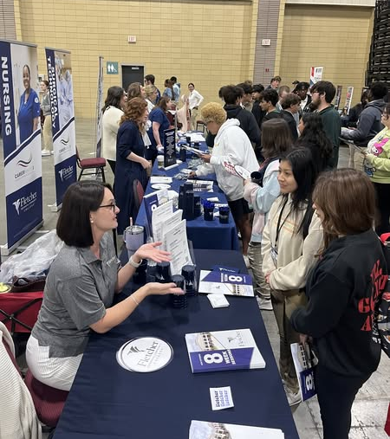
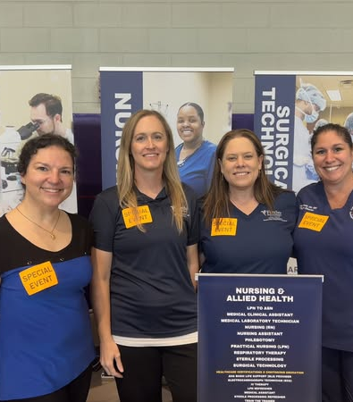

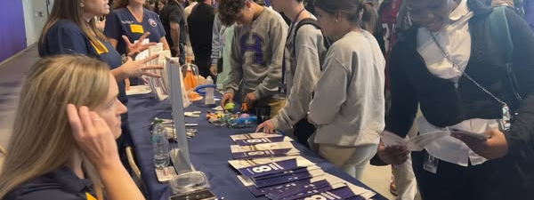
Recruitment Events
Notes:
Open House events on campus
Go to them! Not just career fairs, but find a biology or health instructor and spend the day in his/ her classroom talking to each class.
Attend those career fairs. Don’t rely on enrollment services or college recruiters…. Go sell your program
Offer prizes at open house events
Have interactive hands on demonstrations to attract students to your table (Periop Sim, Lap Sim)…. Offer a prize
You have to grab their attention. Four-year institutions don’t always have to do things like this but our smaller colleges need to let people know we’re out there

Slide 7
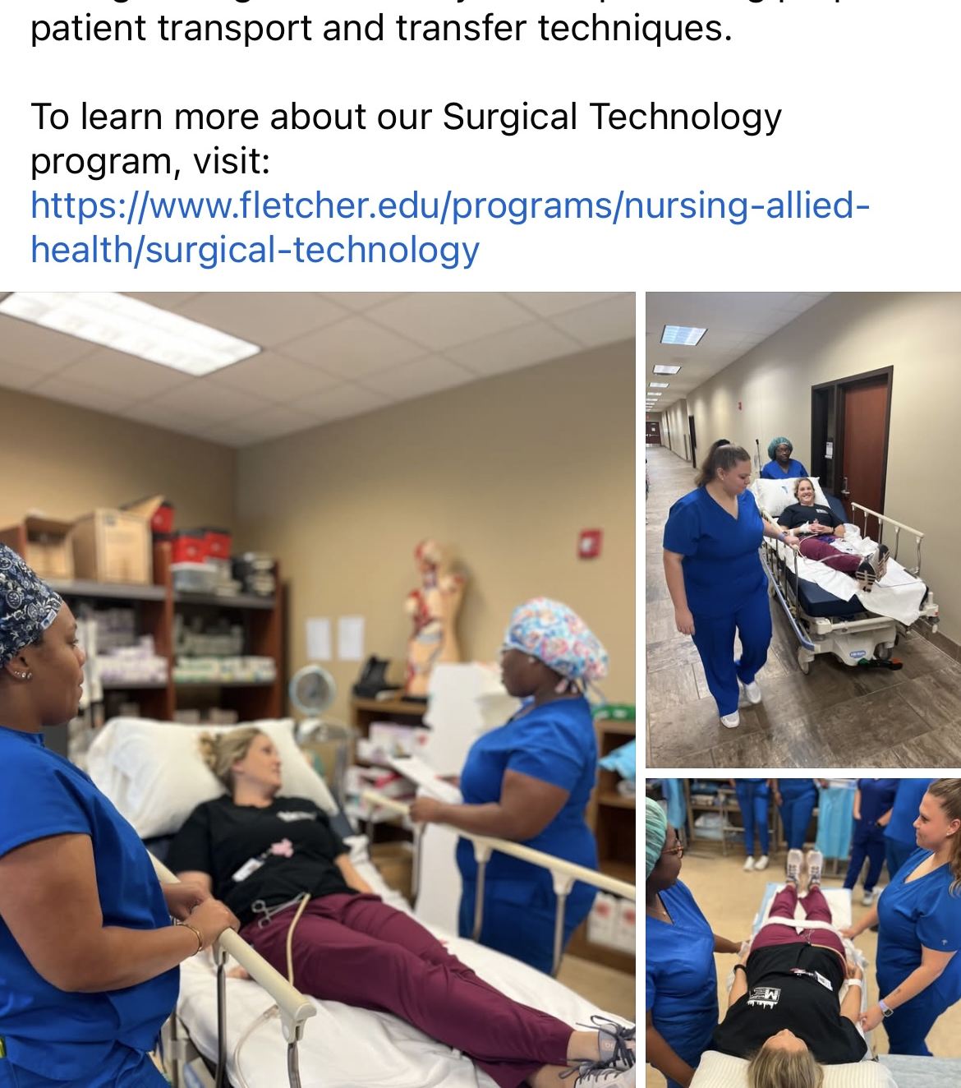
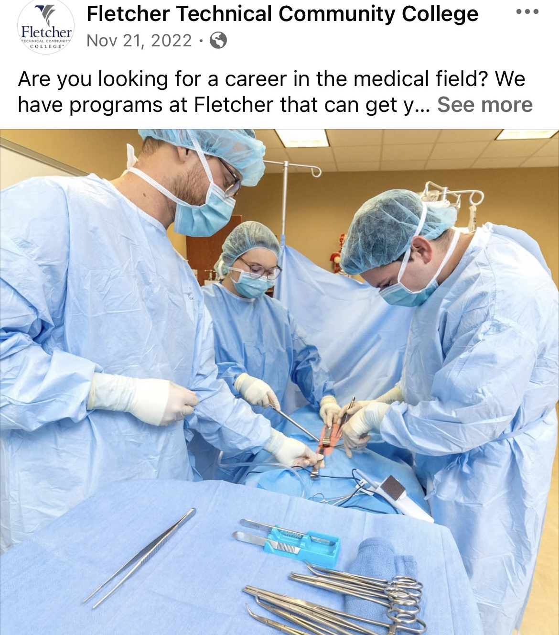
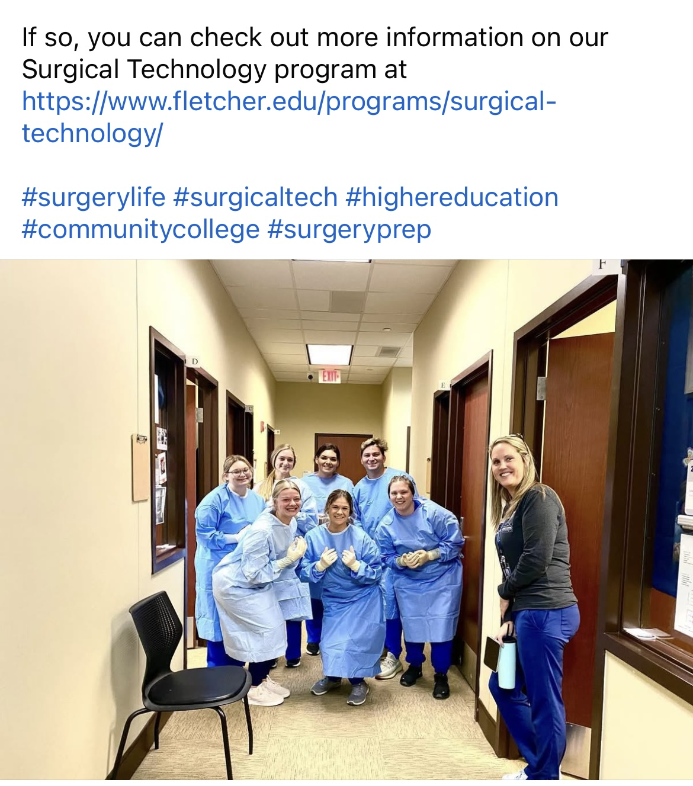
Marketing Initiatives
Notes:
Social media…. Make yourself present! It may seem like just fun in the classroom, but letting the public know about you is the best marketing. Share the college’s posts…. Your students will too,…. Everyone knows someone that will see it

Slide 8
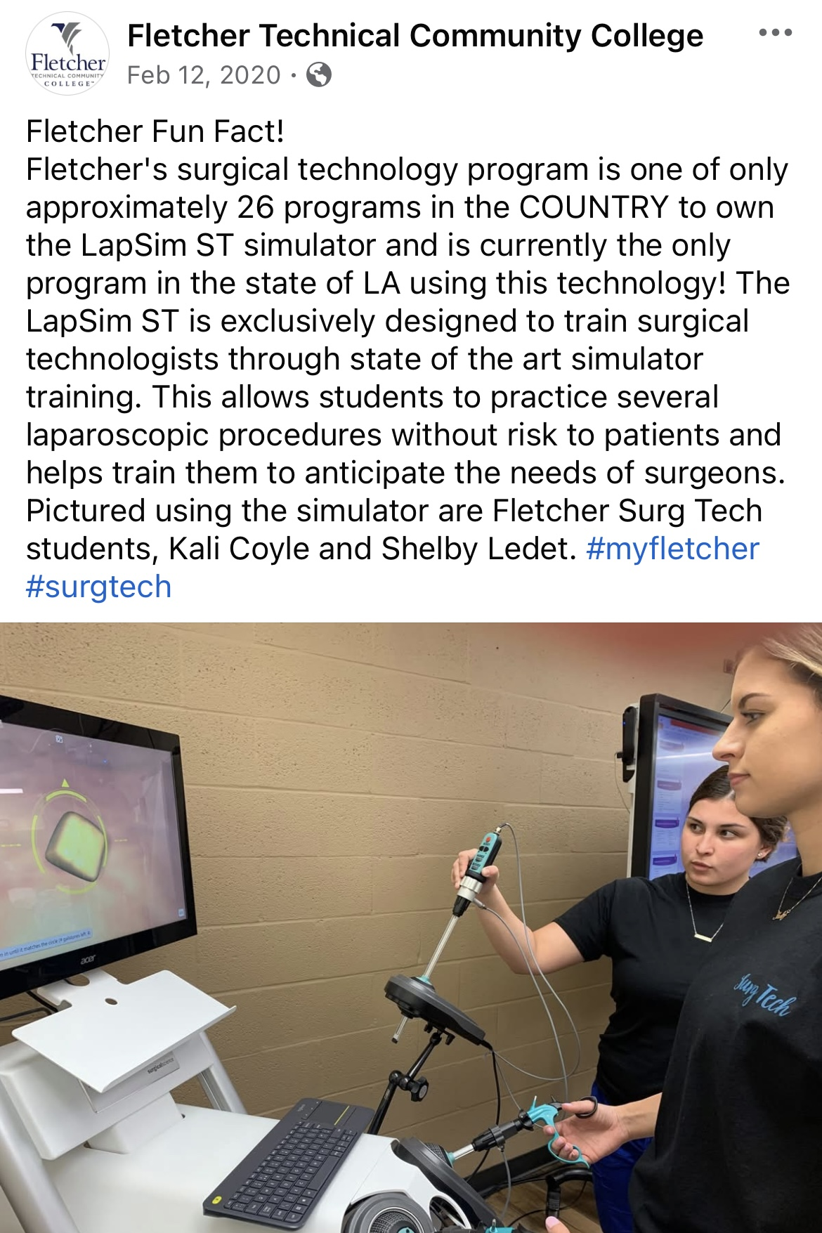
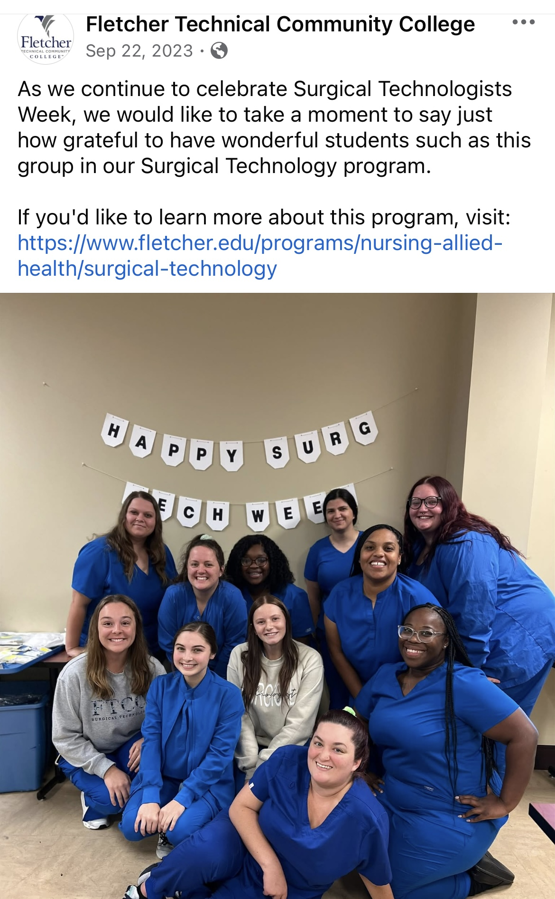
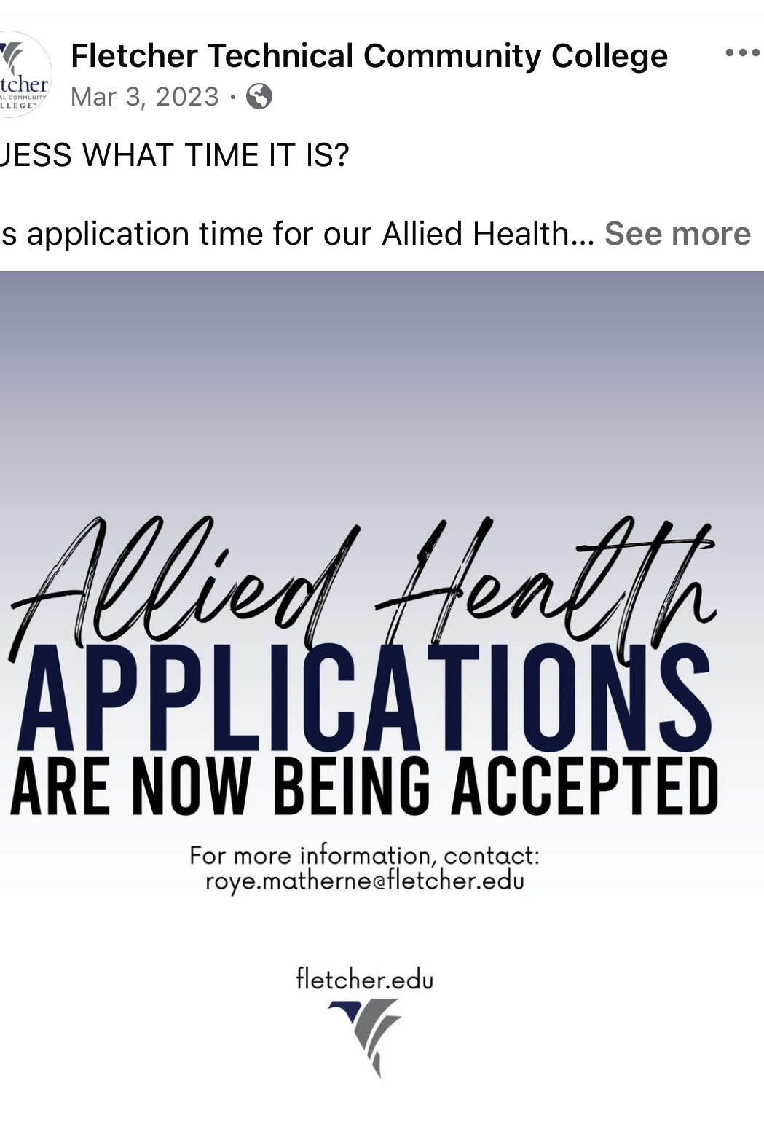
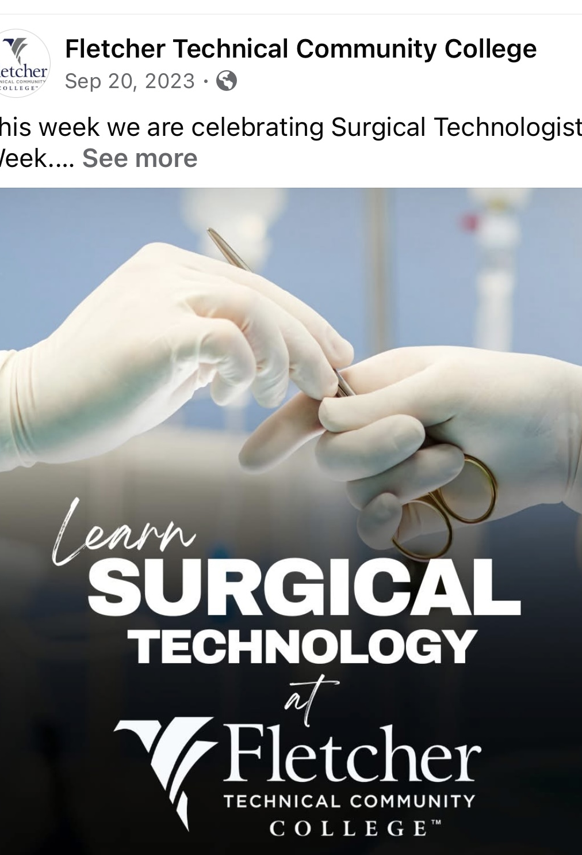
Marketing Initiatives
Notes:
Announce when you’re accepting applications.
Announce cool things that you may be the only one in your state or area… or one of a few in the country to have.
Celebrate Surg Tech Week
If your school has a marketing team…. Set some time with them to make a schedule to push your program.

Slide 9
Introductory Course
Background of Problem
Purpose of Study
Students enter the program not having the proper professional identity the job requires
Students enter the program with misconceptions of the job description
Program retention suffers when students drop after they realize the career is not what they expected
Identify if offering this course as a prerequisite to the clinical component improves career awareness, professional identity, and program retention.
Notes:
Prior to curriculum change, this course was taught in the first semester of program acceptance. At that point, if a student realizes this is not the right career path, it is too late to offer a spot to another applicant.
Background checks, drug screens, physicals, late in getting books, etc.
Limited seat capacity due to programmatic accreditation board requirements and clinical site availability
Previous students thought the field was sterile processing and not going into actual surgeries, thought it would be more like nursing, just knew they wanted to be in the medical field, etc.
Program retention suffered due to the lack of awareness of what the field really was
Will offering this course as a prerequisite to the application improve the problem?

Slide 10
Intro Course Impact on Professional Identity
Important to understand how students choose certain career paths.
A career course can positively influence students’ ability to navigate decision-making processes and career choice certainty.
PI is important to develop through foundation courses. Limited tools to gauge those of allied health students.
Students must develop a preference followed by a confidence in their field. This is critical to foster from the beginning of a program.

Slide 11
Pre-Course Findings (Open-Ended Question)
Rank | Influential Factor
1 | Always wanted to be in the medical field
2 | It seems interesting
3 | Not accepted/ second choice/ didn’t pass nursing school
3 | Interested in surgery/ surgery shows
4 | Desire to help others/ help save someone’s life
5 | Job security/ financial stability
5 | Previously thought about becoming a surgeon
Top 5 Influential Factors for Choosing Surgical Technology as a Major

Slide 12
Additional Responses
Told it was a good career
Enjoy working with teams
Believe it’s a career I can enjoy
Versatile/ never boring
Do not want to be a surgeon or a nurse
Previous personal experience having surgery

Slide 13
Response Analysis
Most desire to be in the medical field
Have a passion to help others
No substantial proof prior research was done in the field
Most answers were generic leaving question if they understand the field
Goal of course coincides well with answers… Help them understand the profession
Question would be better served offering choices and allowing to choose as many that apply (have sense changed to this)

Slide 14
Quantitative Pre- & Post- Course Questions
I understand the job description of a surgical technologist
I know what the term “surgical conscience” means & its importance in the job of a surgical technologist
I understand what the terms asepsis & sterile technique mean
I know the difference between pre-, intra-, & post-operative phases of surgery
I know what the unrestricted, semi-restricted, & restricted areas of the operating room are & the proper attire that must be worn in each
I know the roles of sterile & non-sterile team members
I understand the needs of various patient populations & the requirements of the role of a surgical technologist plays in their care
I understand the legal & ethical considerations as they pertain to patient care regarding the role of a surgical technologist
I understand the dangers & hazards of the operating room environment for myself & the patients I will care for
Notes:
Same questions were used for pre- and post-course surveys.
Questions were based on course outline, learning objectives, and outcomes

Slide 15
Pre- and Post-Course Analysis
Pre-course
Post-Course
Same participants responded with same answers frequently
Some may have prior knowledge leading to strongly agree/ agree responses
Some had no knowledge leading to strongly disagree/ disagree responses
All responded with strongly agree/ agree
Some did not complete post-course survey
Some admitted in written response option they thought they knew before but realized they did not
Creating skewed data for pre-course survey
Notes:
Course questions have since been changed to multiple choice style questions for better accuracy

Slide 16
Post-Course Findings (Open-Ended Questions)
Question: Do you still plan on pursing surgical technology as a career, or do you have reservations? * 56 responses submitted over 3 years.
Answer | Percentage | Number of Responses
Yes, I plan to continue in Surgical Technology | 85.71% | 48
No, I will not pursue Surgical Technology | 5.36% | 3
Still unsure/ applying to multiple programs before deciding | 8.93% | 5

Slide 17
Follow-Up on Program Participants
Students Accepted to Program | Students Retained after 1st Semester | Students Graduated after 4th semester
Summer 2022: 8 | 8 | Summer 2023: 8
Summer 2023: 12 | 12 | Summer 2024: 11
Summer 2024: 16 | 14 | Summer 2025: TBD

Slide 18
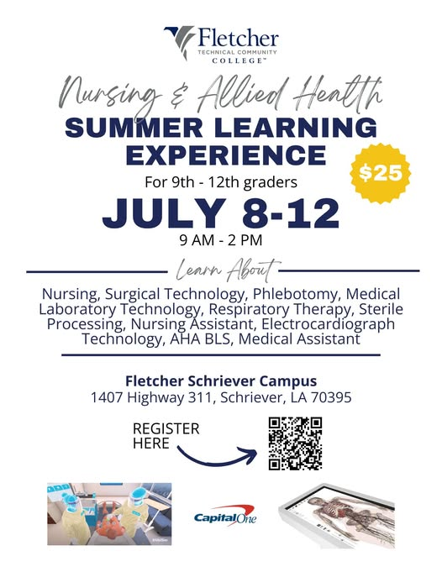
Summer Learning Experience
Spend time with each N&AH program offered
Tour campus & local facilities
Hands-on skills
Q&A
Has increased interest in program
Some come back following year
Offering twice in 2025 due to high demand
Become AHA BLS certified.

Slide 19
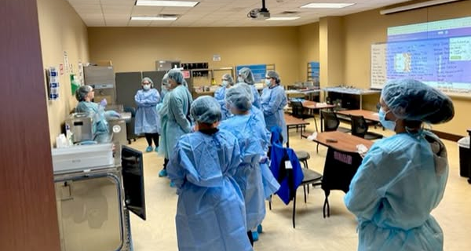
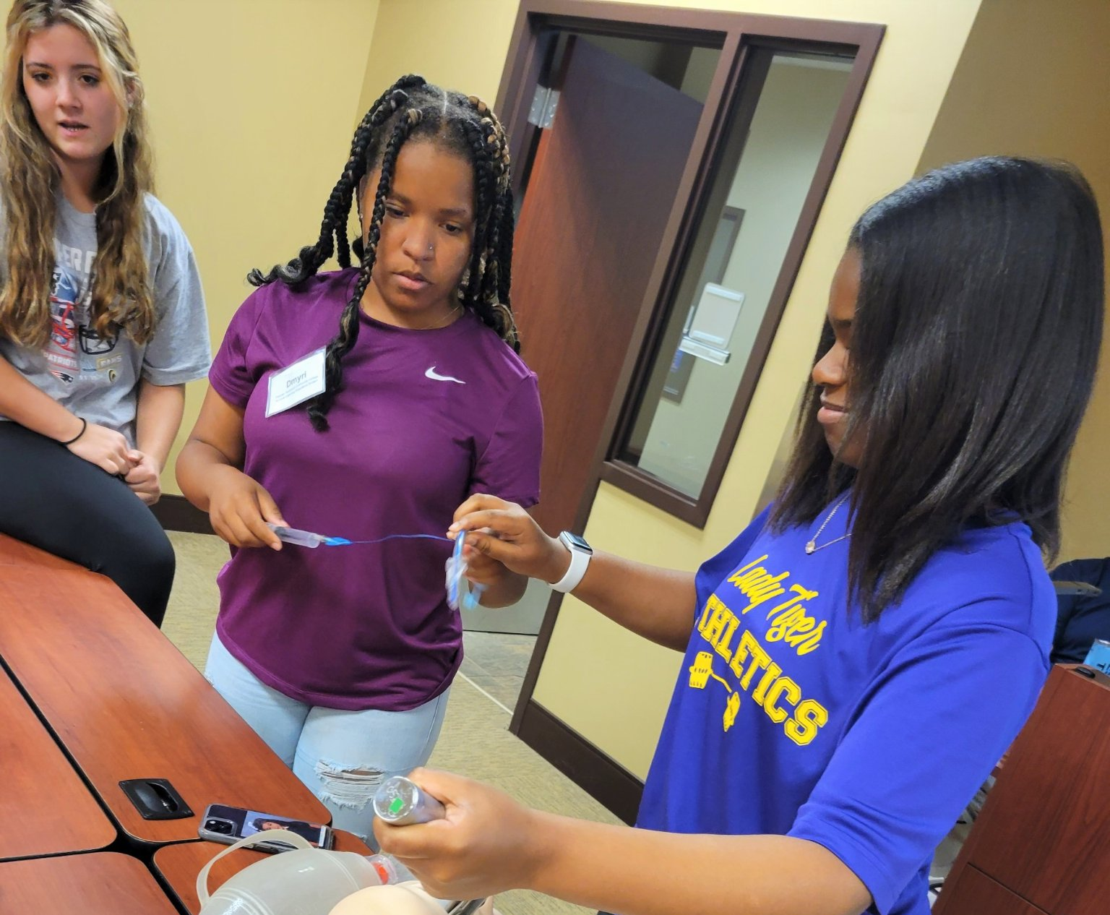
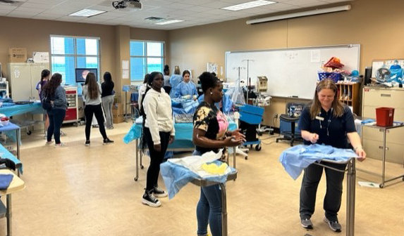
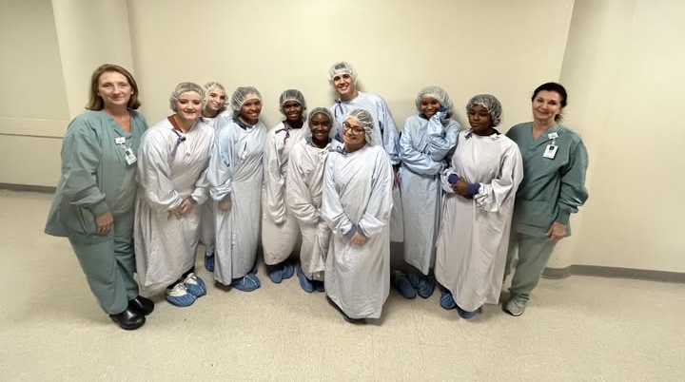
Notes:
Programs do hands on activities with each group.
Hospitals give tours to students in all of the areas of interest they participated in throughout the week.

Slide 20
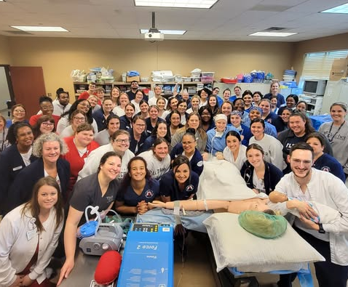
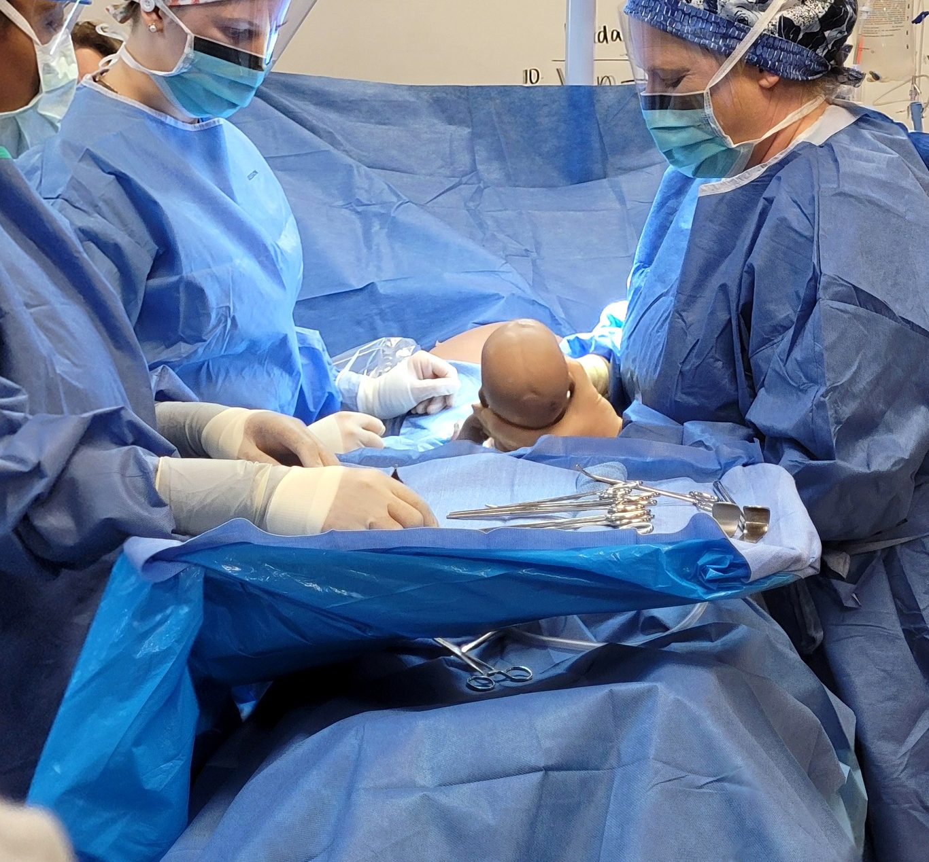
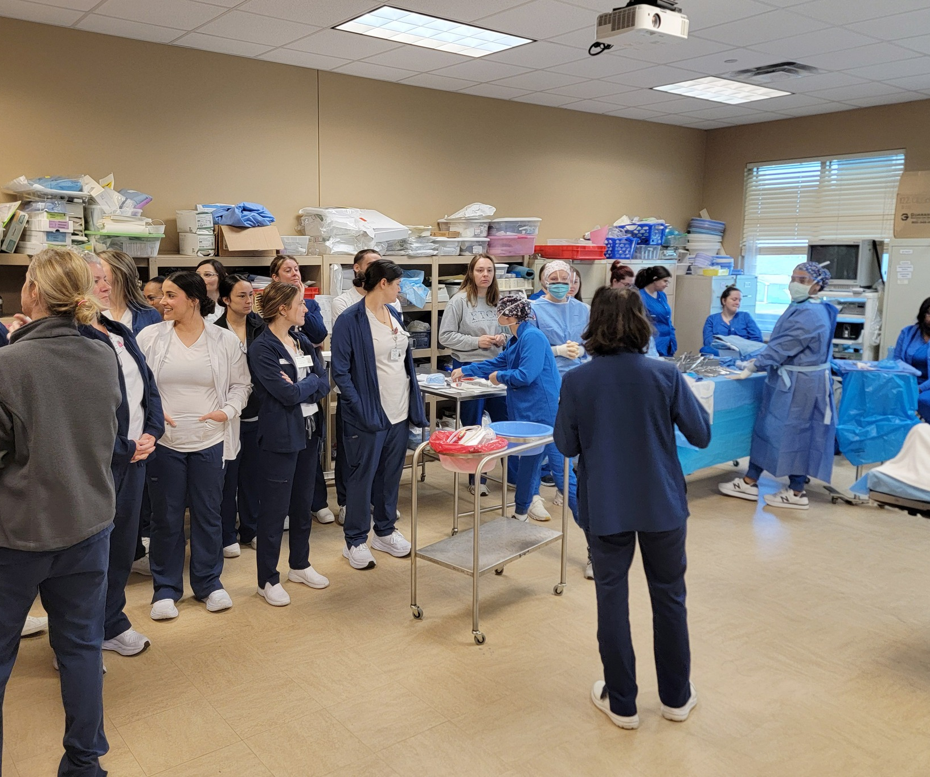
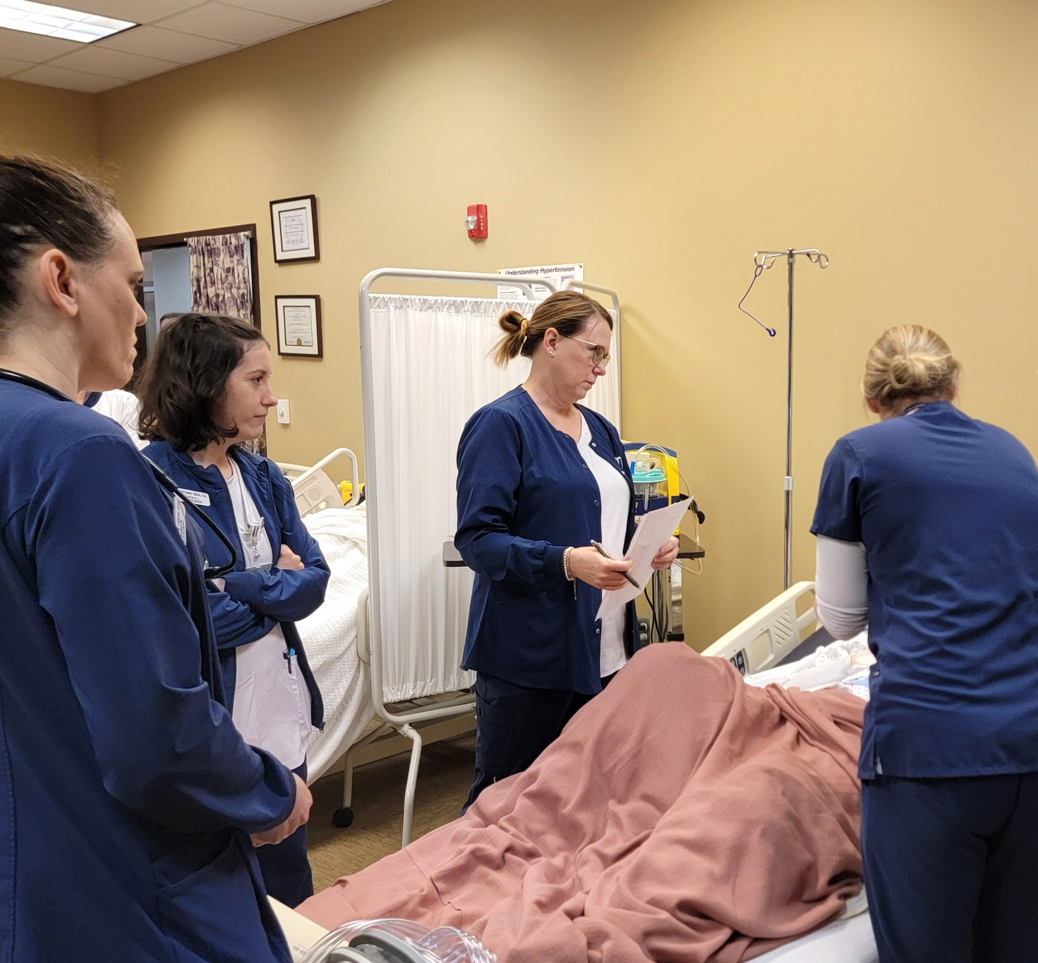
Interdepartmental Simulation Days
Mock Emergency C-Section
Programs Participating:
  Nursing
  Surgical Technology
  Respiratory Therapy
  Phlebotomy/ MLT

Slide 21
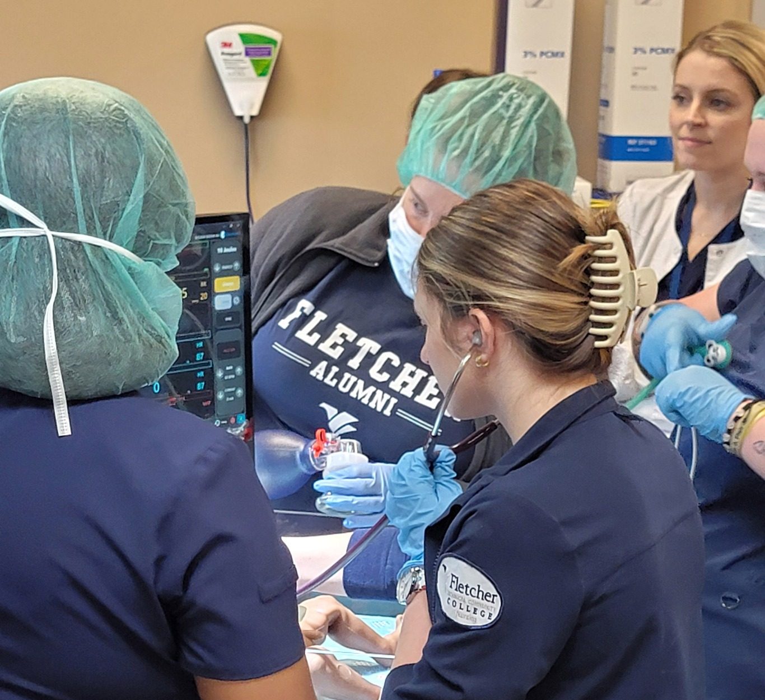
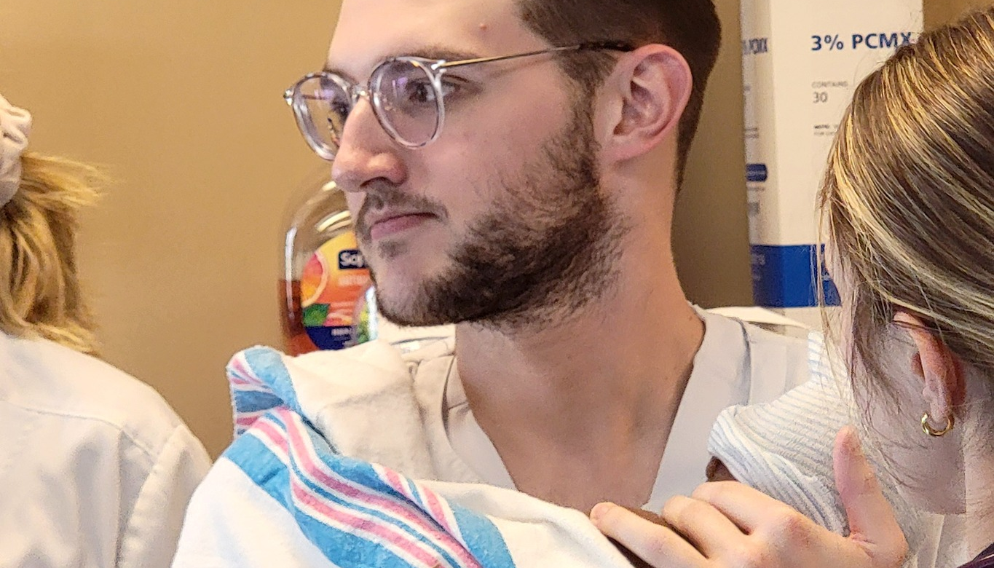
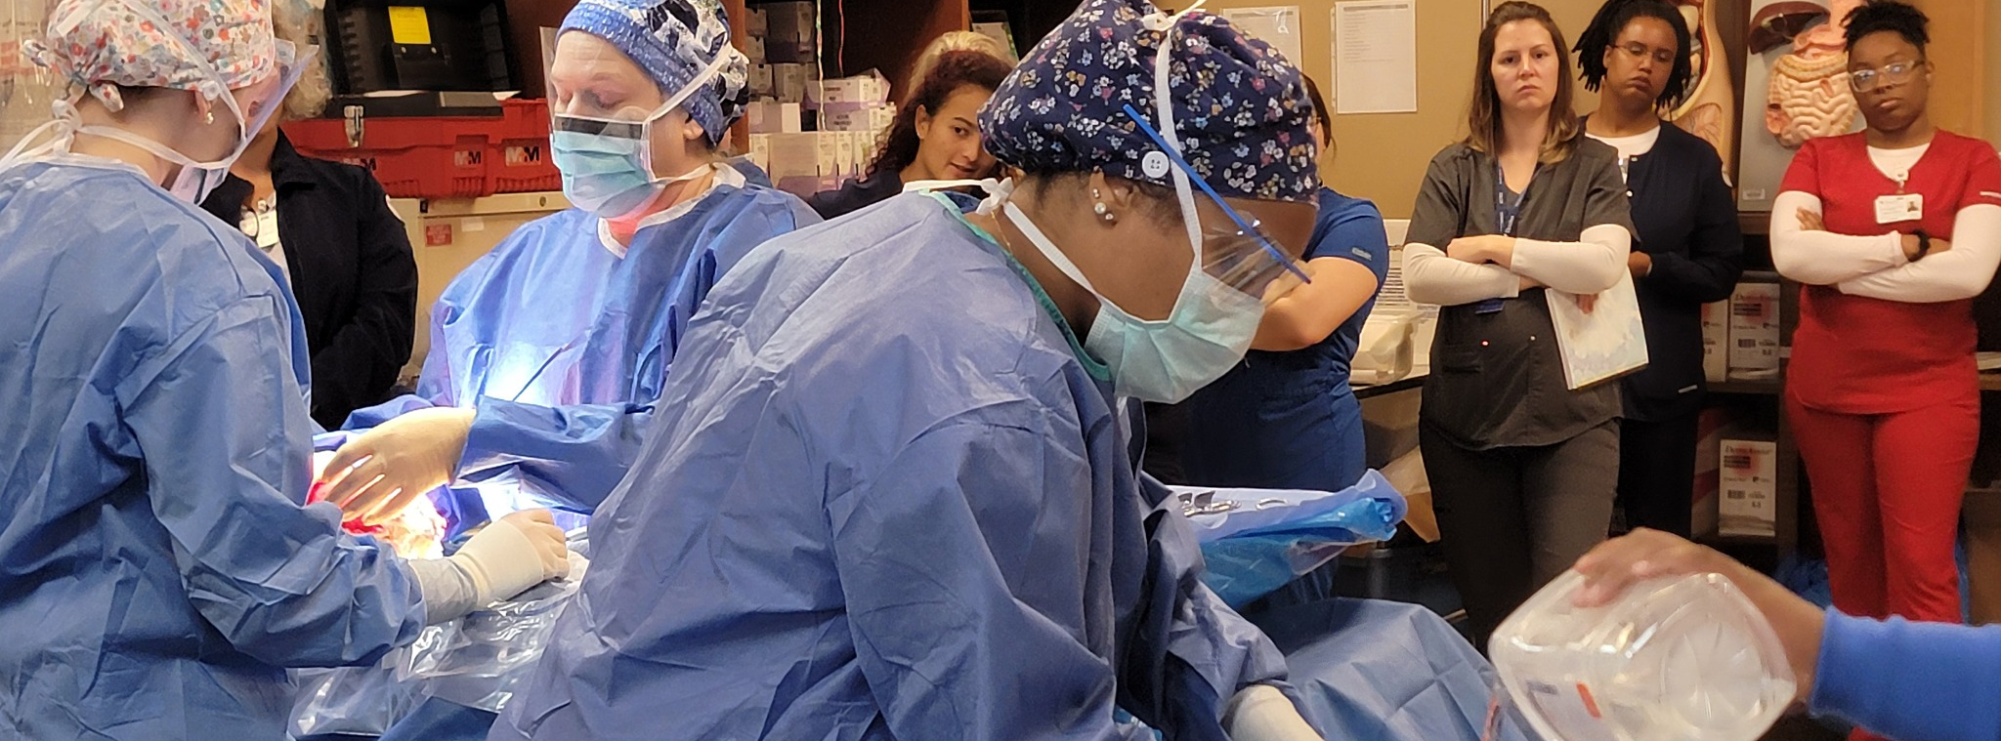

Slide 22

Daily Huddles
  Leadership & Enrollment Services meet each morning on TEAMS to go over college enrollment efforts & goals
    Discuss hurdles/ barriers
  Rainbow list of students not registered
    Continuing Students from Fall , not registered for Spring
    Applied for Spring, not registered
    Registered for Fall, not retained to 14th day
    Registered for Spring (previous year), not registered for Fall.
  Everyone responsible for reaching out
    Report daily to tracking sheet (phone calls, texts, emails, walk-ins)
  Numbers reported every morning
    During registration periods through 1st day of semester

Slide 23


This Photo by Unknown Author is licensed under CC BY-SA-NC

Slide 24
References
Freeman, V., Lenz, J., & Reardon, R. (2017). Career course impact on college students’ career decision and affective states: https://www.counseling.org/docs/default-source/ vistas/ article.
Institute for Higher Education Policy. (2022). Strategic enrollment management: Best practices for technical programs. Retrieved from https://www.ihep.org
Stock, P., & Stock, E. (2017). Factors that influence a college student’s choice of an academic major and minor. Journal of Scholastic Inquiry: Business, 9(1), 1-11.

